Slide 1

Catch-An-Eye
What is CATCH-AN-EYE?
Proyect developed by Jeronimo Romero and Juan Ignacio Zullo

Slide 2
Developedmental stages
01
02
03
04
05
06
Team organization
Initial plannig
Early Development
Testing & Feedback
Required Improvements
Distribution of the final product

Slide 3
01
Team organization

Slide 4
Main functions
Innovation and real help
Practical and economical solution
Inclusion and accessibility
The social impact on the project
Own development
Innovation and real help
Because we can

Slide 5
02
Initial planning

Slide 6



Main functions
Easy access
Guided cursor movement
Easy access
Primary actions

Slide 7



Time organization
01
02
03
Investigation
Implementation
Initial tests

Slide 8



Time organization
04
05
06
Testing
Final product
Marketing and Diffusion

Slide 9
03
Early Development

Slide 10
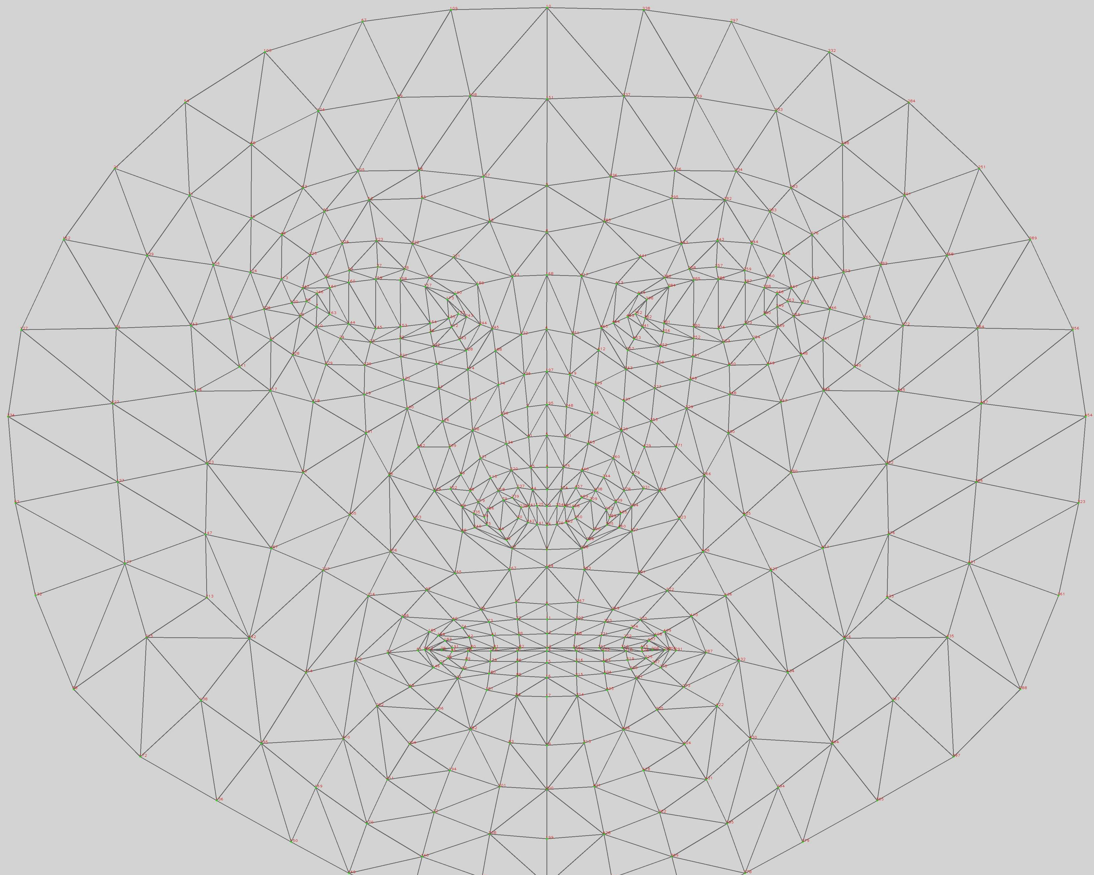
Face Mesh (Landmarks)
Pointer’s Movement (Nose)
Clicks (Wink)
Scroll (Both eyes)
Drag (Sustained Wink)
478 points located all over the face, especially on the nose, eyes and mouth

Slide 11



Important Dependencies
For this Project we used many dependencies for various áreas such as calculation, rendering, compatibility, among others:
Mediapipe (Rendering)
OpenCV (Compatibility)
PyAutoGUI (Compatibility)
NumPy (Calculation)
One-Euro Filter (Calculation)

Slide 12
04
Testing & Feedback

Slide 13
Testing Stretegy
Main Functions
Unexpected Behavior
Performance in Differents Computers
Poor Code Optimization
Ability to be Intuitive
Confusing Instructions
Continuous/Daily Use
Situational Errors

Slide 14
05
Required Improvements

Slide 15


The Final Step: An Instalation
Installable Program
Generates an installer with its respective
PyInstaller
NSIS
Portable Program
Package the code in a single .exe file

Slide 16
06
Distribution of the final product

Slide 17


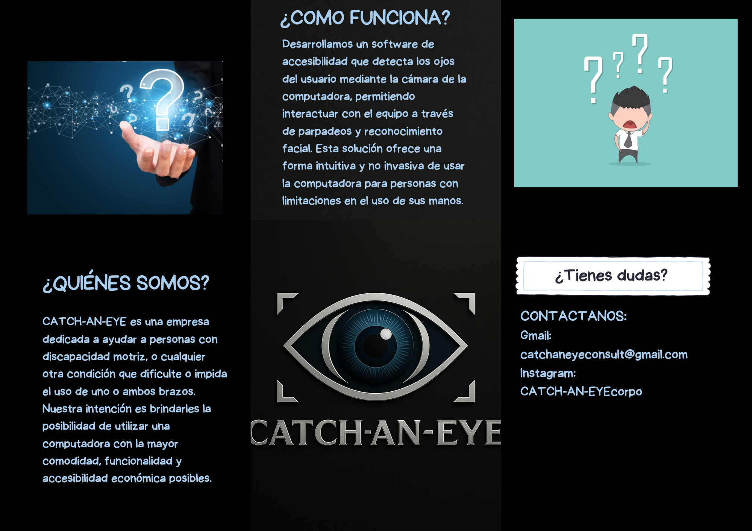
Instagram
word of mouth
Digital and physical flyers

Slide 18
Thanks for watching!
Jeronimo Romero y Juan Ignacio Zullo --- Catch-An-Eye’s Development Team

